Slide 1

WEB-technology Project documentary
Presented By : Beksultan Moldakhmet

Slide 2
Project Overview
Project Name: Memory Game
Description: A memory game where players need to find pairs of matching cards.
Technologies Used: HTML, CSS, JavaScript

Slide 3
﻿Project Goals
create a memory game where users can select a difficulty level.
Implemented with HTML, CSS, and JavaScript:
Dynamic card creation.
Timer functionality.
Displaying win/loss messages.

Slide 4
Technology used
Html
CSS
JAVASCript
Structure of the page, interface elements.
Styling for cards, buttons, background, etc.
Game logic, event handling, timer management, card matching validation.

Slide 5
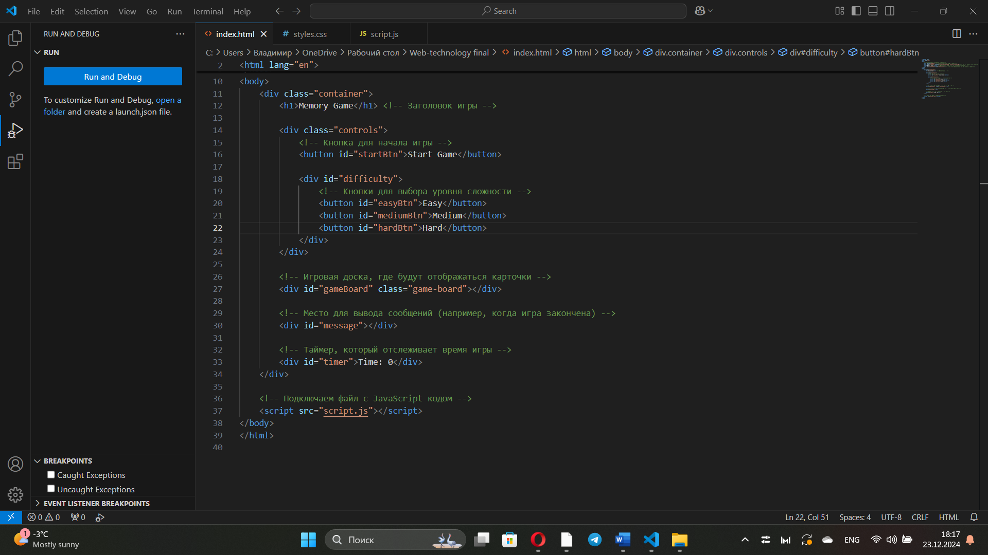
HTML - Page Structure
Explanation:
<div class="container">: The main container for the entire page.
<h1>: Title of the game.
<div class="controls">: Container for control buttons.
Difficulty buttons: Elements for selecting the game difficulty (Easy, Medium, Hard).
<div id="gameBoard">: Where the cards will be displayed.
<div id="message">: Displays the win or loss message.
<div id="timer">: Displays the game timer.

Slide 6
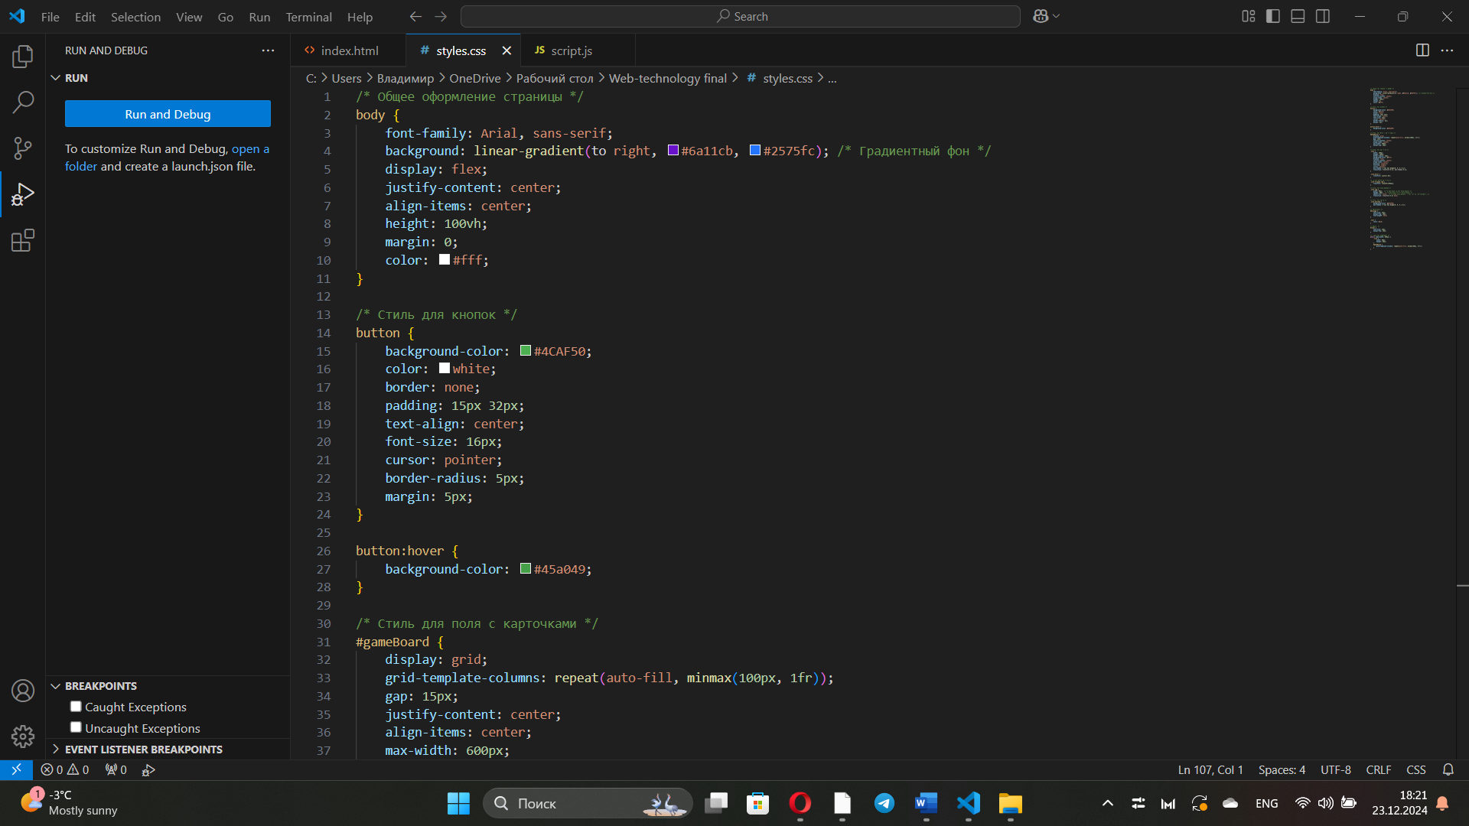
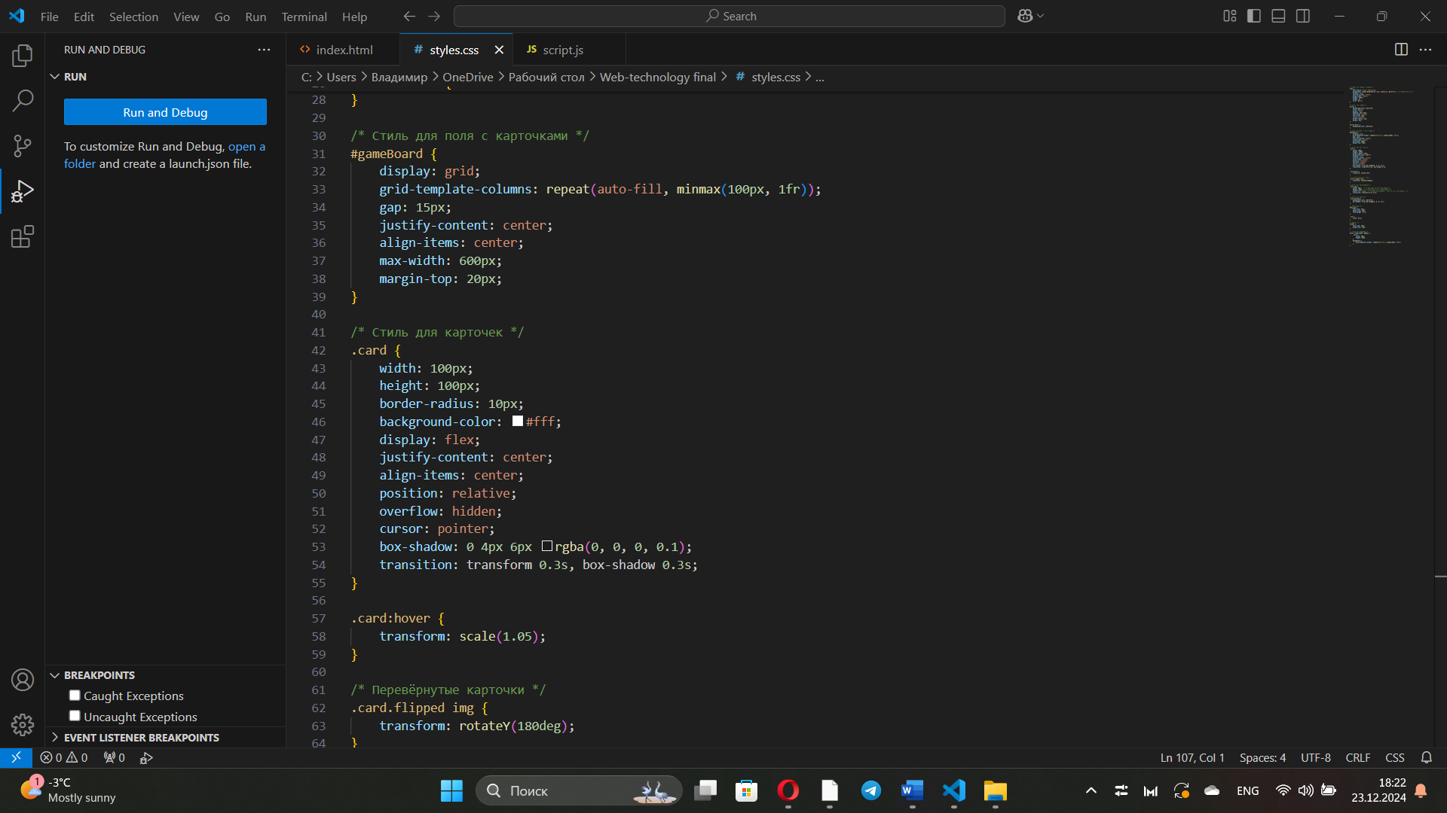
CSS - Page Styling
Explanation:
body {}: Styles for the page background and layout.
Gradient background and Flexbox for centering the content.
button {}: Button styling.
Button background color, font size, rounded corners, and hover effect.
.card {}: Card styling.
Card size, border radius, and center alignment of card content.

Slide 7
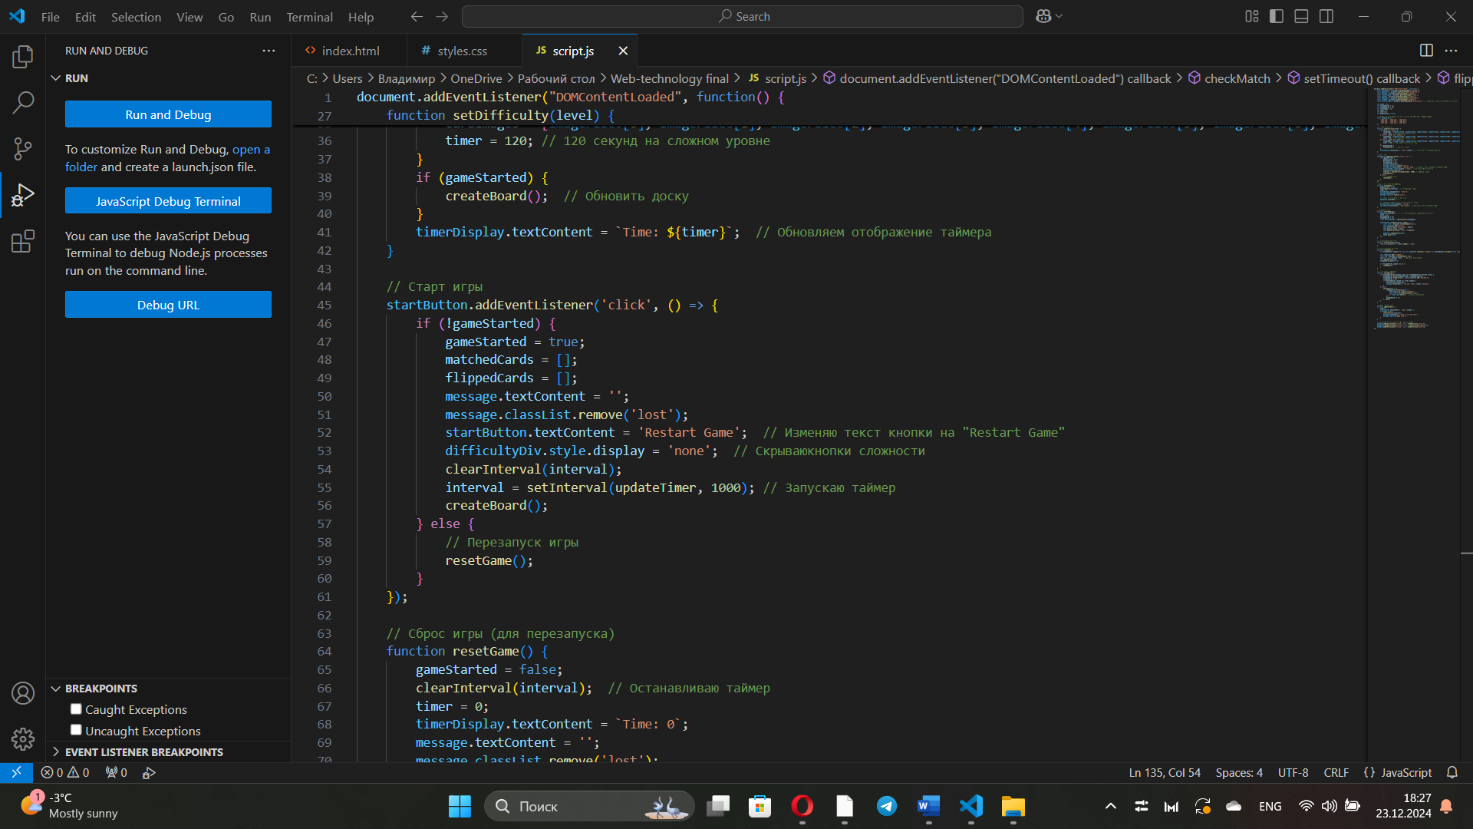
JavaScript - Starting the Game
Explanation:
startButton.addEventListener('click', () => { ... }): Adds a click event listener to the "Start Game" button.
Inside the event handler, it checks if the game has started (gameStarted):
If not, the game starts and the board is created.
If the game has already started, it resets the game.

Slide 8
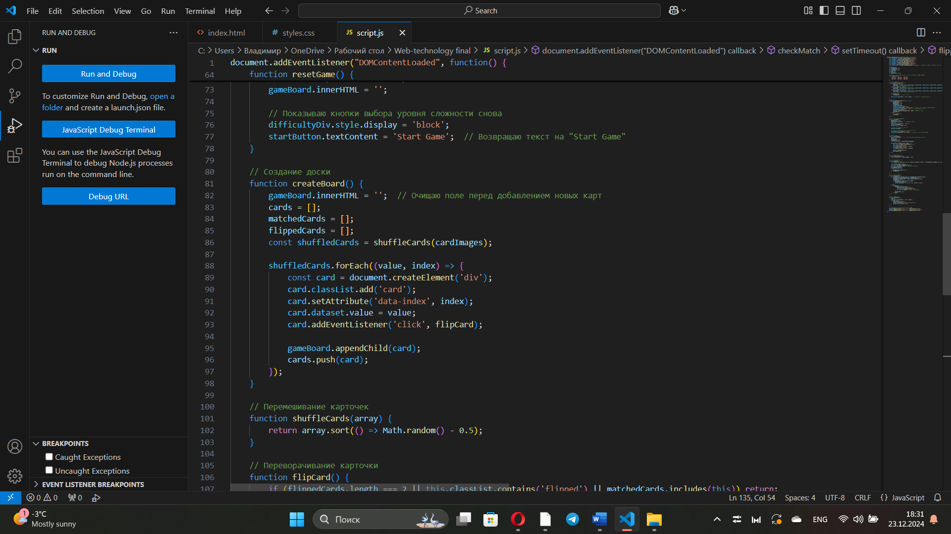
JavaScript - Creating the Game Board
Explanation:
gameBoard.innerHTML = '';: Clears the game board before adding new cards.
shuffleCards(cardImages): Shuffles the card images to randomize their placement on the board.
card.addEventListener('click', flipCard);: Adds a click event listener to flip the card when clicked.
gameBoard.appendChild(card);: Adds the card to the board.

Slide 9
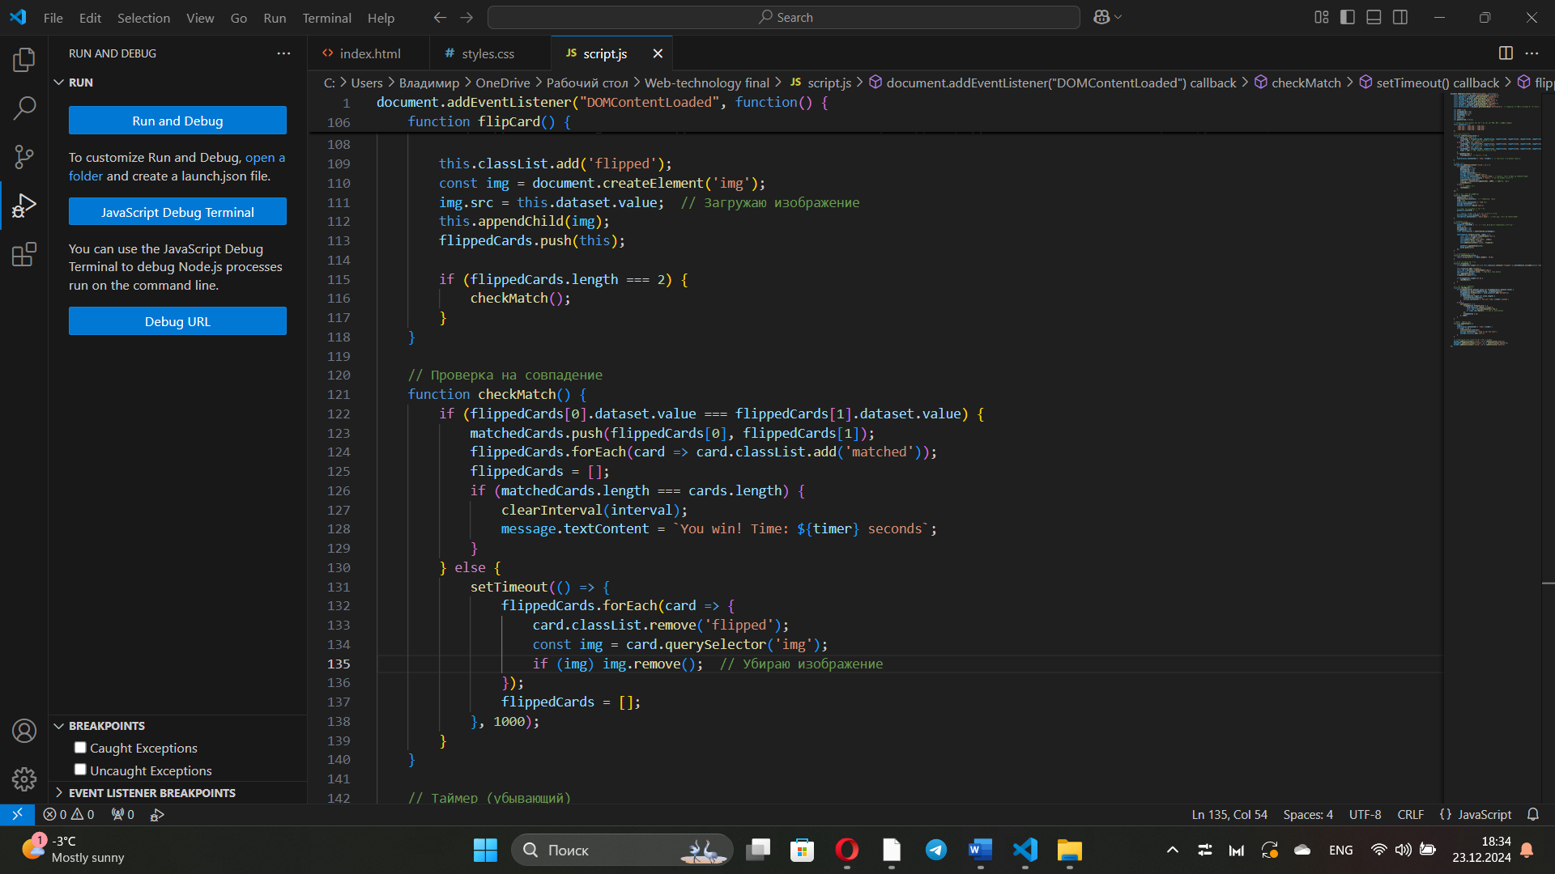
JavaScript - Checking for Matches
Explanation:
flippedCards[0].dataset.value === flippedCards[1].dataset.value: Checks if the flipped cards match.
If they match, they are added to the matchedCards array and marked as matched.
If not, the cards are flipped back after a short delay (1 second).

Slide 10
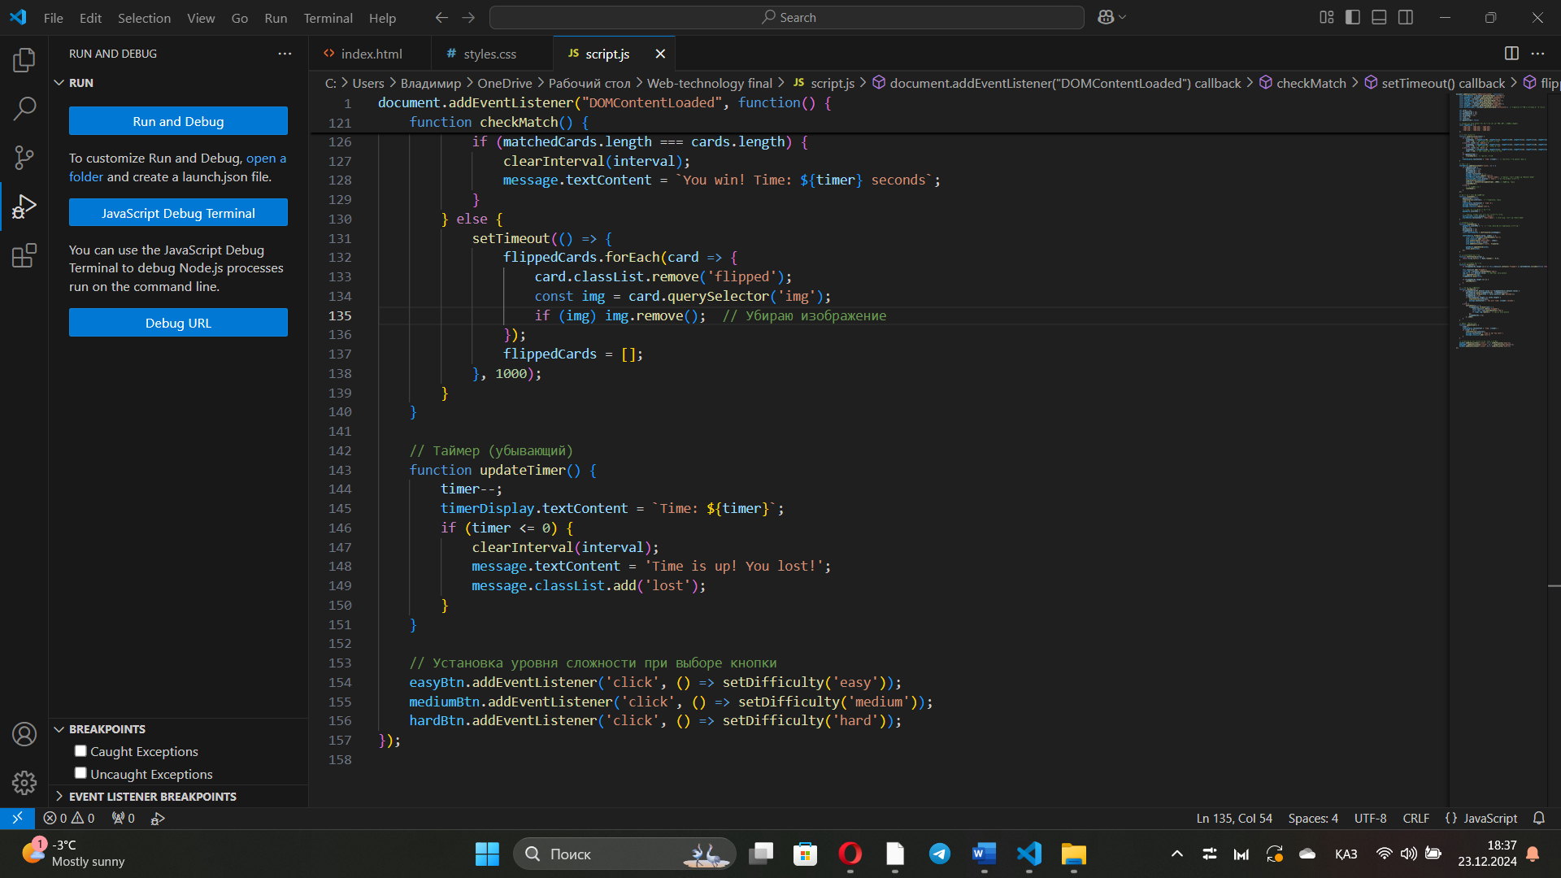
JavaScript - Timer
Explanation:
timer--;: Decreases the timer by one every second.
clearInterval(interval);: Stops the timer when time runs out.
message.textContent = 'Time is up! You lost!';: Displays a "Time is up!" message when the timer reaches zero.

Slide 11
Conclusion
The project successfully implements a memory game using HTML, CSS, and JavaScript.
The game allows players to select a difficulty level, with dynamic card creation and a timer.

